Slide 1
Design and Analysis of Algorithms
Greedy Algorithms (Ch16)

Slide 2
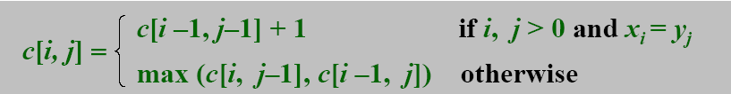
Simple Review
LCS
Max Sum
  b[j]=max( b[j-1]+a[j], a[j] ), 1<=j<=n.

Slide 3
Design and Analysis of Algorithms
Greedy Algorithms
Topics:
Activity-selection problem
Elements of the greedy strategy
Huffman coding

Slide 4
Examples of Greedy Algorithms
Scheduling
  Activity Selection (Chap 16.1)
  Minimizing time in system
  Deadline scheduling (Chap 16.5)
Graph Algorithms
  Minimum Spanning Trees (Chap 23)
  Dijkstra’s (shortest path) Algorithm (Chap 24.3)
Other Heuristics
  Huffman coding (Chap 16.3)
  Coloring a graph
  Traveling Salesman Problem(Chap 35.2)
  Set-covering (Chap 35.3)
  Subset-sum problem (Chap 35.5)

Slide 5
Greedy Method
For many optimization problem, Dynamic Programming is overkill. A greedy algorithm always make the choice that looks best at every step. That is, it makes local optimal solution in the hope that this choice will lead to a globally optimal one.
  I make the shortest path to the target at each step. Sometime I win, sometime I lose.

Slide 6
Activity-Selection Problem
Problem: Given a set A = {a₁, a₂, …, a_{n}} of n activities with start and finish times (s_{i}, f_{i}), 1 ≤ i ≤ n, select maximal set S of “non-overlapping” activities.
  One can think of the problem as corresponding to scheduling the maximal number of classes (given their start and finish times) in one classroom.
Solution:
  Sort activities by finish times (let a₁, a₂ , …, a_{n} denote sorted sequence)
  Pick first activity a₁
  Remove all activities with start time before finish time of a₁
  Recursively solve problem on remaining activities.

Slide 7

Activity Selection
Here is the problem from the book:
  Activity a₁ starts at s₁ = 1, finishes at f₁ = 4.
  Activity a₂ starts at s₂ = 3, finishes at f₂ = 5.
  Activity a₃ starts at s₃ = 0, finishes at f₃ = 6 ...
Got the idea?
  The set S is sorted in monotonically increasing order of finish time.The subsets of {a₃, a₉, a₁₁} and {a₁, a₄, a₈ , a₁₁}are mutually compatible.

Slide 8
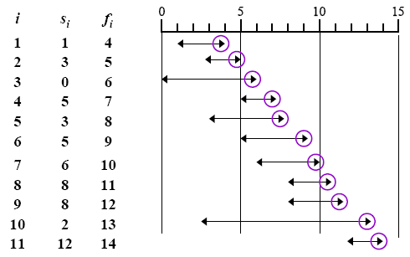
Activity Selection

Slide 9
Activity Selection
Objective: to create a set of maximum activities a_{i} that are compatible.
  Modeling the subproblems: Create a set of activities that can start after a_{i} finishes, and finish before activity a_{j} starts.
  Let S_{ij} be that set of activities. S_{ij} = { a_{k} ∈ S : f_{i} ≤ s_{k} < f_{k} ≤ s_{j} } ⊆ S where S is the complete set of activities, only one of which can be scheduled at any particular time. (They share a resource, which happens, in a way, to be a room).

Slide 10
Property of S_{ij}
We add fictitious activities a₀ and a_{n+1} and adopt the conventions that f₀ = 0, s_{n+1} = ∞. Assume activities are sorted by increasing finishing times:f₀ ≤ f₁ ≤ f₂ ≤ ... ≤ f_{n}< f_{n+1}. Then S = S_{0, n+1}, for 0 ≤ i, j ≤ n+1.
Property 1. S_{ij} = φ if i ≥ j.
  Proof Suppose i ≥ j and S_{ij} ≠ φ, then there exists a_{k} such that f_{i} ≤ s_{k} < f_{k} ≤ s_{j}< f_{j}, therefore f_{i} < f_{j}. But i ≥ j implies that f_{i} ≥ f_{j}, that’s a contradiction.
Notes:
Fictitious:假想的, 编造的, 虚伪的, 习惯上假定的, 假想的

Slide 11
Optimal Substructure
The optimal substructure of this problem is as follows:
  Suppose we have an optimal solution A_{ij} to S_{ij} include a_{k}, i.e., a_{k} ∈ S_{ij}. Then the activities that make up S_{ij} can be represented by A_{ij} = A_{ik} ∪ {a_{k}} ∪ A_{kj}
We apply cut-and-paste argument to prove the optimal substructure property.

Slide 12

A recursive solution
Define c[i, j] as the number of activities in a maximum-size subset of mutually compatible activities. Then
Converting a dynamic-programming solution to a greedy solution.
  We may still write a tabular, bottom-up, dynamic programming algorithm based on recurrence.
  But we can obtain a simplified solution by transforming a dynamic-programming solution into a greedy solution.

Slide 13
Greedy choice property
Theorem 16.1 Consider any nonempty subproblem S_{ij}, and let a_{m} be the activity in S_{ij} with the earliest finish time: f_{m} = min{ f_{k} : a_{k} ∈ S_{ij} }.
  Then 1. Activity a_{m} is used in some maximum-size subset of mutually compatible activities of S_{ij}. 2. The subproblem S_{im} is empty, so that choosing a_{m} leaves the subproblem S_{mj} as the only one that may be nonempty.
The above is a statement claiming that Activity Selection has the greedy choice property. What is it?
Why is Theorem 16.1 so valuable? How many… ?

Slide 14
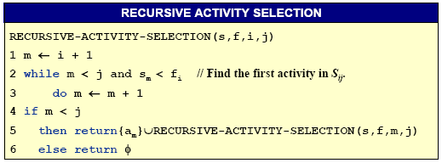
A recursive greedy algorithm
The procedure RECURSIVE-ACTIVITY-SELECTION is almost “tail recursive”: it ends with a recursive call to itself followed by a union operation. It is a straightforward task to transform a tail-recursive procedure to an iterative form.

Slide 15
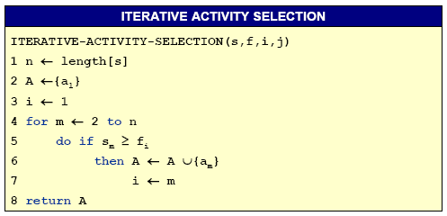
An iterative greedy algorithm
This procedure schedules a set of n activities in Θ(n) time, assuming that the activities were already sorted initially by their finish times.

Slide 16
When Greedy Algorithm Works?
How can one tell if a greedy algorithm will solve a particular optimization problem? There is no way in general. If we can demonstrate the following properties, then it is probable to use greedy algorithm:
  Greedy-choice property
  Optimal substructure (the same with that of dynamic programming)

Slide 17
Elements of Greedy Strategy
Greedy-choice property: a global optimal solution can be arrived at by making local optimal (greedy) choice
  Greedy strategy progresses in a “top-down” (instead of bottom up in dynamic programming), iteratively reducing each given problem to a smaller one
Optimal substructure: if an optimal solution to the problem contains within it optimal solutions to subproblems
  Be able to demonstrate that if optimal solution A with s₁, then the set A’ = A - {s₁} is an optimal solution to a smaller problem w/o s₁.

Slide 18
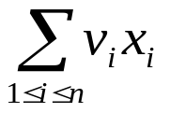
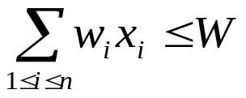
Knapsack Problem
To illustrate the subtleties between the two techniques, let us investigate two variants of a classical optimization problem.
  0-1 knapsack problem
    0-1 knapsack problem: A thief robs a store and finds n items, with item i being worth $v_{i} and having weight w_{i} pounds, The thief can carry at most W ∈ N in his knapsack but he wants to take as valuable a load as possible. Which item should he take?
    i.e., is maximized and s.t.
  Fractional knapsack problem
    The setup is the same, but the thief can take fractions of items.

Slide 19
Optimal Substructure
Both knapsack problems exhibit the optimal substructure property:
  For 0-1 knapsack problem, if we remove item j from this load, the remaining load must be at most valuable items weighing at most W-w_{j} from n -1 items.
  For fractional one, if we remove a weight w of one item j from the optimal load, then the remaining load must be the most valuable load weighing at most W -w that the thief can take from the n-1 original items plus w_{j} –w pounds of item j.

Slide 20

Fractional Knapsack
There are 5 items that have a value and weight list below, the knapsack can contain at most 100 Lbs.
Method 1 choose the least weight first
  Total Weight = 10 + 20 + 30 + 40 = 100
  Total Value = 20 + 30 + 65 + 40 = 155
Method 2 choose the most expensive first
  Total Weight = 30 + 50 + 20 = 100
  Total Value = 65 + 60 + 20 = 145
Method 3 choose the most value/ weight per unit first
  Total Weight = 30 + 10 + 20 + 40 = 100
  Total Value = 65 + 20 + 30 + 48 = 163
What can you draw?

Slide 21
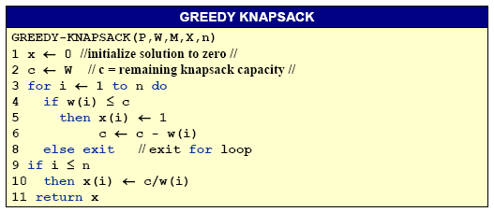
Greedy for Fractional Knapsack
p, w,W, x, n
p(1:n) and w(1:n) contain the values and weights respectively of the n items ordered so that p(i)/w(i) ≥ p(i+1)/w(i+1). W is the knapsack size and x(1:n) is the solution vector.

Slide 22
Greedy strategy
Some time we do not sort, but select the best one from the residuals each time.
measurement
Original n inputs
?
A(1)
A(2)
…
A(n)
Sorted n inputs
A’(1)
A’(2)
…
A’(n)
?
?
S(x)
S(y)
…
Local optimal solution

Slide 23
Simple Review
Greedy Algorithms
  Activity-Selection Problem
  Elements of Greedy Strategy
    Greedy-choice property
    Optimal substructure (the same with that of dynamic programming)
  Knapsack Problem
    Fractional Knapsack

Slide 24
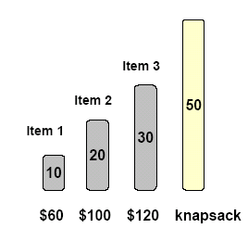
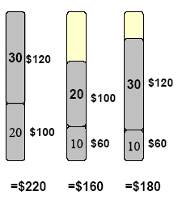
0/1 Knapsack Example
0-1 knapsack problem can be solved in time O(n⋅w) using dynamic-programming.

Slide 25
Optimal Substructure (0/1sack)
Objectives:
  Let c[i, j] represents the total value that can be taken from the first i items when the knapsack can hold j.
  Our Objective is to get the maximum value for c[n, W]
    where n is the number of given items and W is the maximum weight of items that the thief can put it in his knapsack.
Optimal Substructure
  If an optimal solution contains item n, the remaining choices must constitute an optimal solution to similar problem on items 1, 2, …,n –1 with bound W–w_{n}.
  If an optimal solution does not contain item n, the solution must also be an optimal solution to similar problem on items 1, 2, …, n –1 with bound W.

Slide 26
0-1 Knapsack problem
Let c[i, j] denote the maximum value of the objects that fit in the knapsack, selecting objects from 1 through i with the sack’s weight capacity equal to j. An application of the principle of optimality we have derived the following recurrence for c[i, j]:
c[i, j] = max(c[i –1, j], c[i –1, j – w_{i}] + vi) The boundary conditions are c[0, j] = 0 if j ≥ 0, and c[i, j] = −∞ when j < 0.

Slide 27
0-1 Knapsack problem
There are n = 5 objects with integer weights w[1..5] = {1, 2, 5, 6, 7}, and values v[1..5] = {1, 6, 18, 22, 28}. The following table shows the computations leading to c[5,11] (i.e., assuming a knapsack capacity of 11).
Sack’s Capacity |  |  |  | 0 | 1 | 2 | 3 | 4 | 5 | 6 | 7 | 8 | 9 | 10 | 11
 | w_{i} | v_{i} |  | 0 | 0 | 0 | 0 | 0 | 0 | 0 | 0 | 0 | 0 | 0 | 0
 | 1 | 1 |  | 0 | 1 | 1 | 1 | 1 | 1 | 1 | 1 | 1 | 1 | 1 | 1
 | 2 | 6 |  | 0 | 1 | 6 | 7 | 7 | 7 | 7 | 7 | 7 | 7 | 7 | 7
 | 5 | 18 |  | 0 | 1 | 6 | 7 | 7 | 18 | 19 | 24 | 25 | 25 | 25 | 25
 | 6 | 22 |  | 0 | 1 | 6 | 7 | 7 | 18 | 22 | 24 | 28 | 29 | 29 | 40
 | 7 | 28 |  | 0 | 1 | 6 | 7 | 7 | 18 | 22 | 28 | 29 | 34 | 35 | 40
c[3, 8]
c[4, 8] =max (c[3,8], 22 + c[3, 2])
c[3, 2]

Slide 28

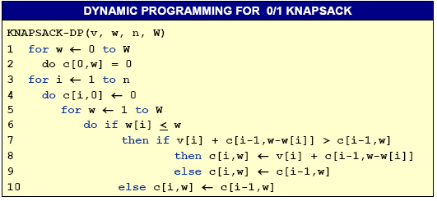
DP for 0-1 Knapsack Problem

Slide 29
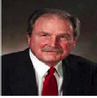
Huffman codes
Data Compression via Huffman Coding
  Motivation
    Limited network bandwidth.
    Limited disk space.
  Human codes are used for data compression.
    Reducing time to transmit large files, and
    Reducing the space required to store them on disk or tape.
  Huffman codes are a widely used and very effective technique for compressing data, savings of 20% to 90% are typical, depending on the characteristics of the data.

Slide 30
Huffman codes
Problem
  Suppose that you have a file of 100K characters. To keep the example simple, suppose that each character is one of the 6 letters from a through f. Since we have just 6 characters, we need just 3 bits to represent a character, so the file requires 300K bits to store. Can we do better?
  Suppose that we have more information about the file:
    the frequency which each character appears.
Solution
  The idea is that we will use a variable length code instead of a fixed length code (3 bits for each character), with fewer bits to store the common characters, and more bits to store the rare characters.

Slide 31

Example of Data Compression
For example, suppose that the characters appear with the following frequencies, and following codes:
Then the variable-length coded version will take not 300K bits but 45∗1 + 13∗3 + 12∗3 + 16∗3 + 9∗4 + 5∗4 = 224K bits to store, a 25% saving. In fact this is the optimal way to encode the 6 characters present, as we shall see.

Slide 32
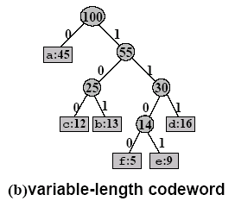
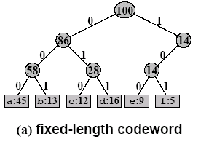
Characteristic of Optimal Code
  Represented as a binary tree whose leaves are the given characters.
  In an optimal code each non-leaf node has two children.

Slide 33
Prefix-free Code
In a Prefix code¹ no codeword is a prefix of another code word.
  Easy encoding and decoding.
To encode, we need only concatenate the codes of consecutive characters in the message.
  The string 110001001101 parses uniquely as 1100-0-100-1101, which decodes to FACE.
To decode, we have to decide where each code begins and ends.
  Easy, since, no codes share a prefix.
1 “prefix-free codes” would be a better name, but the term “prefix codes” is standard in the literature

Slide 34


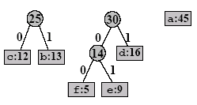

Example of Huffman codes

Slide 35
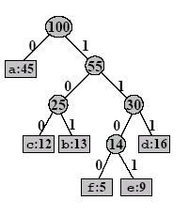
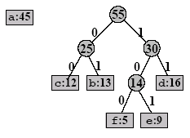
Example of Huffman codes
(cont.)
Notes:
霍夫曼树是带权路径长度(WPL:Weighted Path Length)最小的二叉树

Slide 36
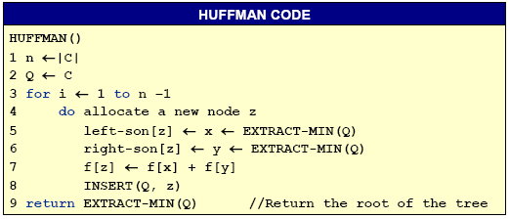
Algorithm of Huffman Coding
The greedy algorithm for computing the optimal Human coding tree T is as follows.
  It starts with a forest of one-node trees representing each c ∈C, and merges them in a greedy style, using a priority queue Q, sorted by the smallest frequency:

